Slide 1
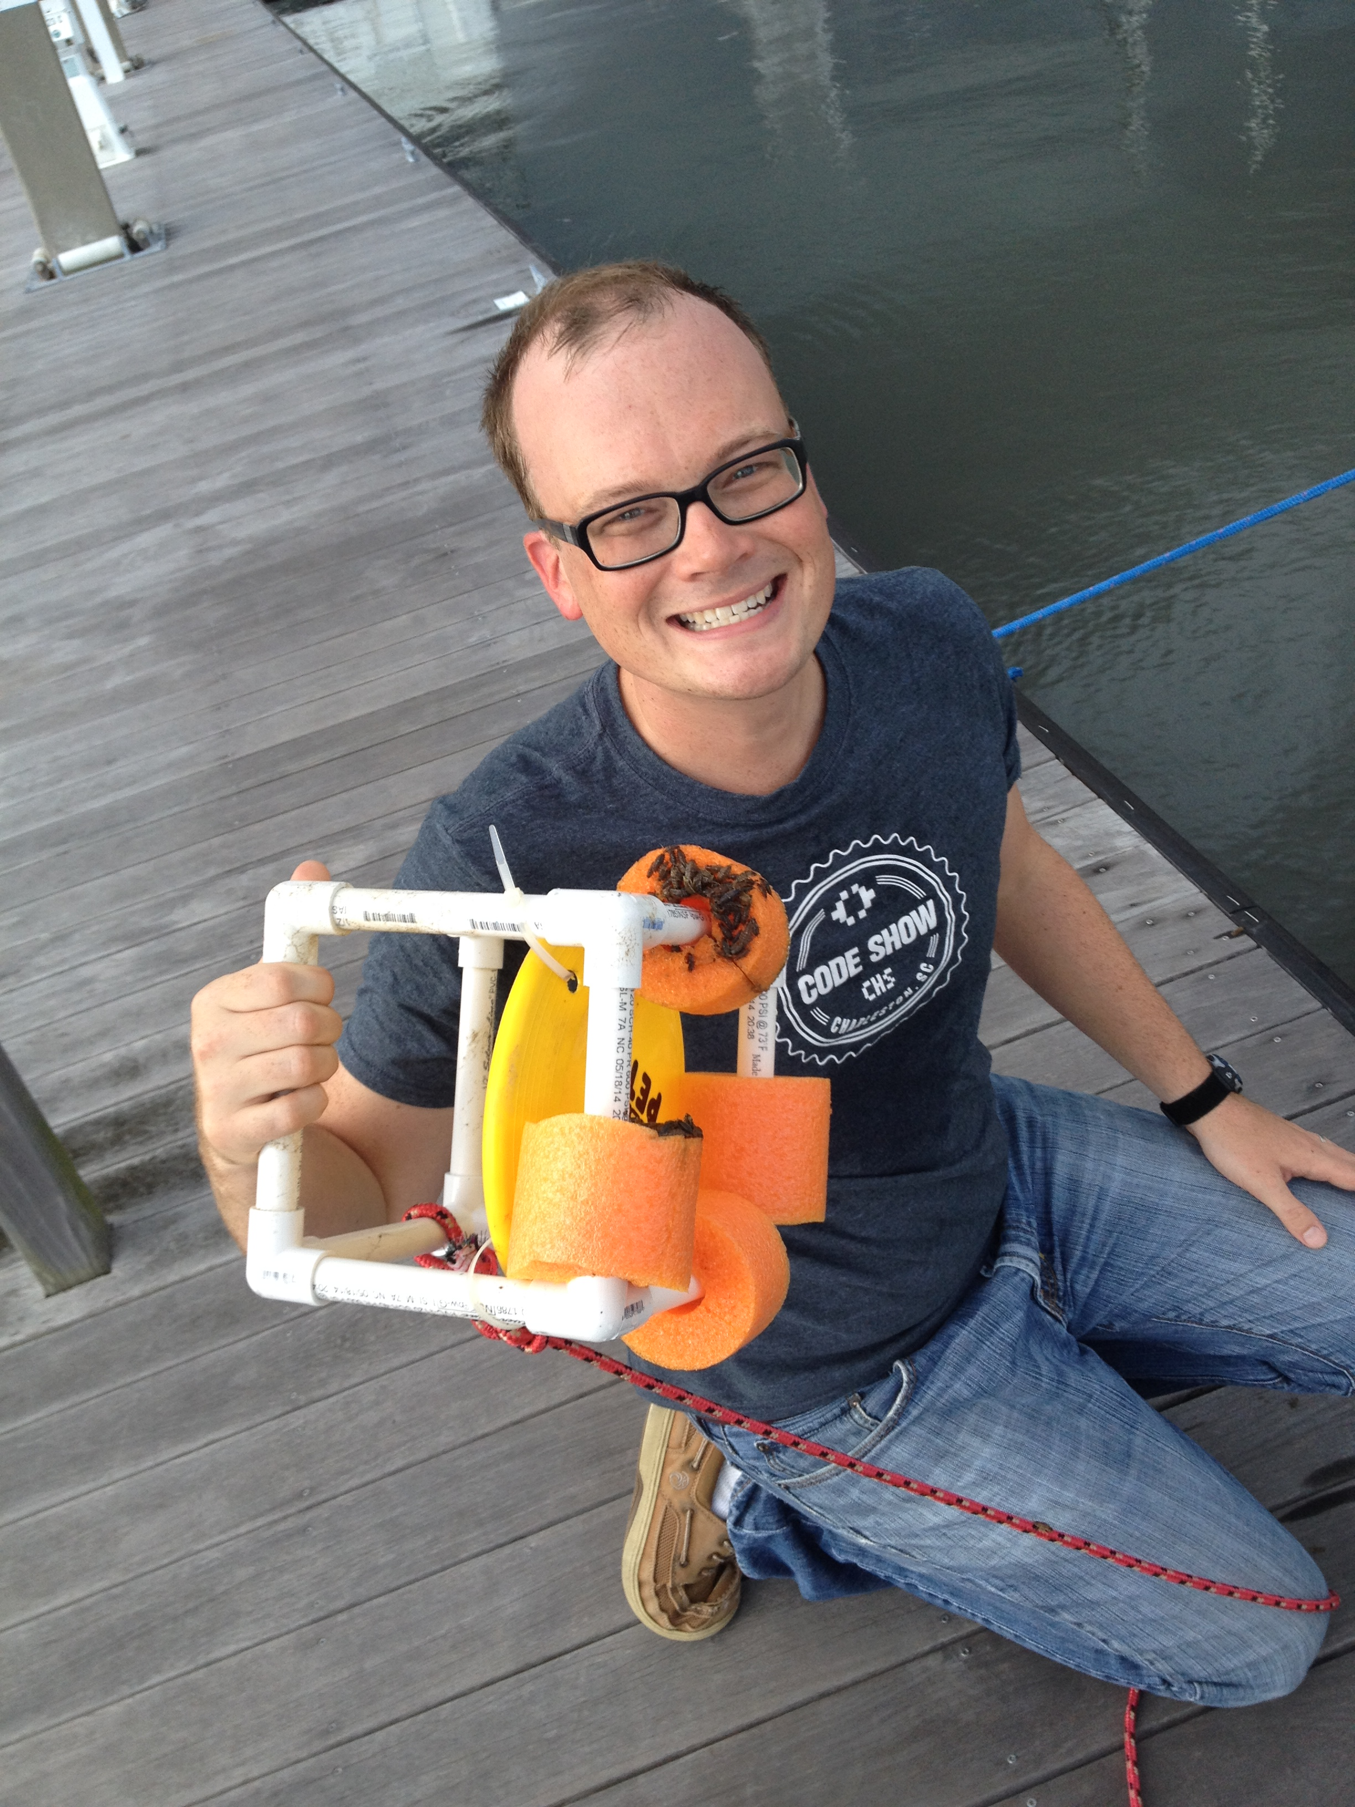

BoBIno

Slide 2

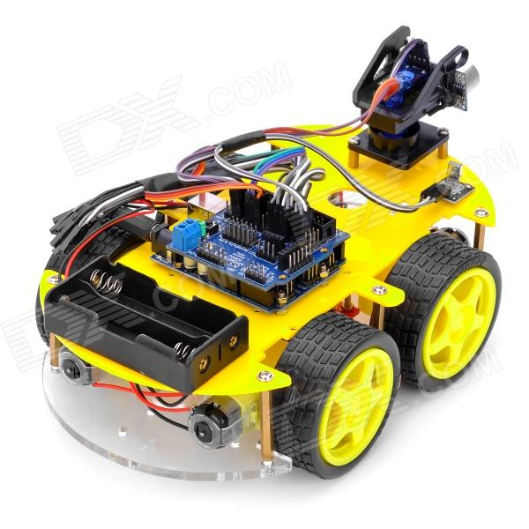
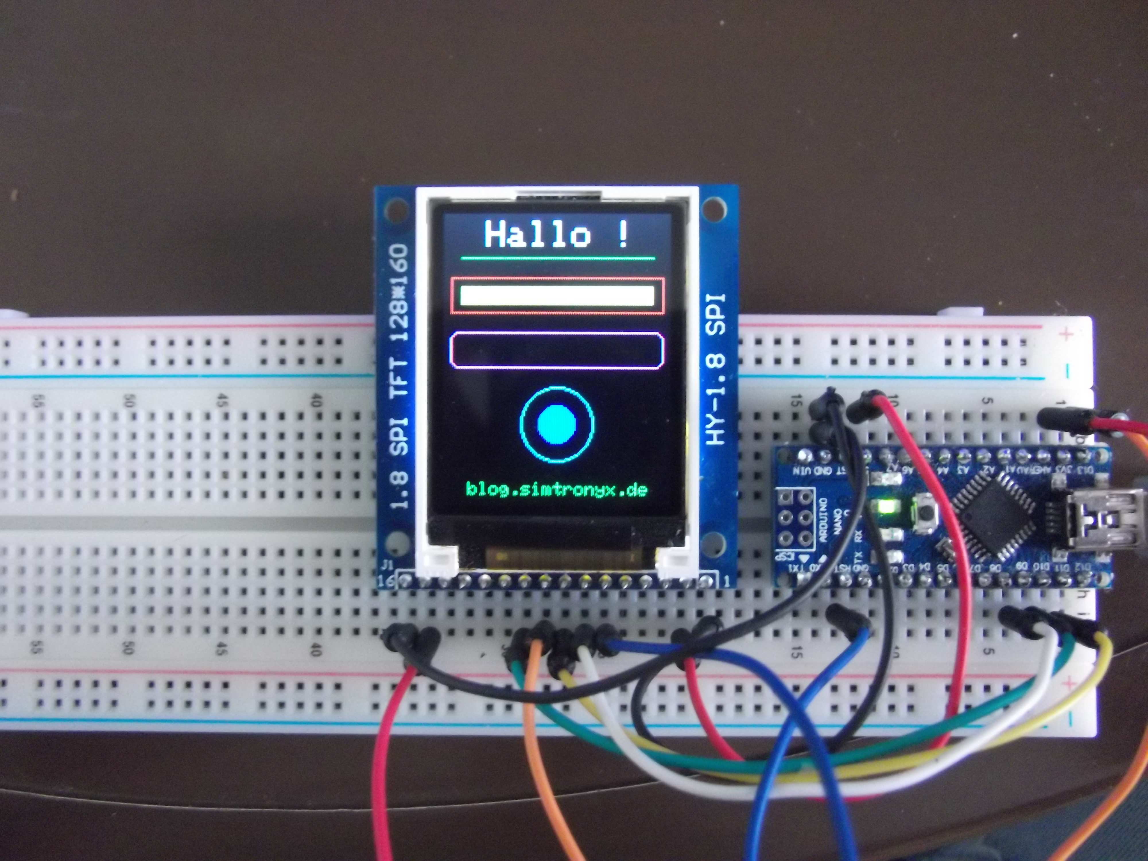

What is Arduino?

Slide 3
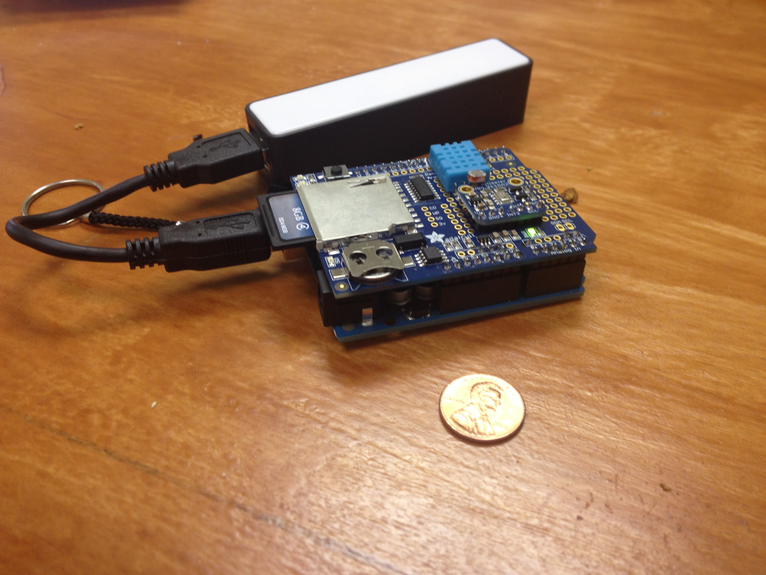
What is the BoBino?
Senor platform, collects:
Temperature
Humidity
Pressure
Light
Compatible with Arduino Systems

Slide 4
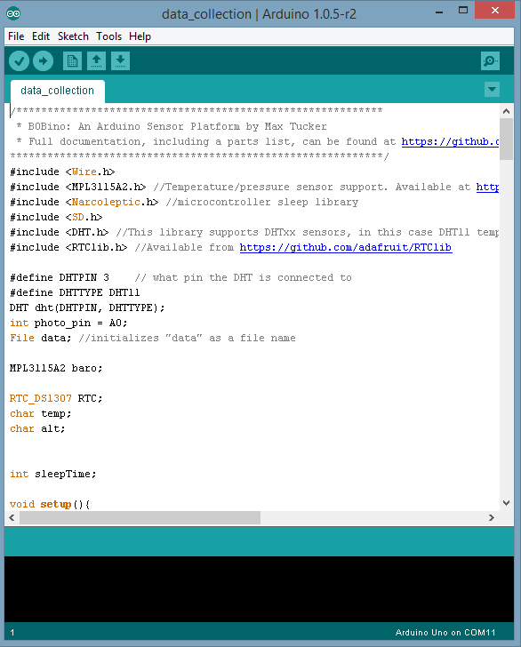
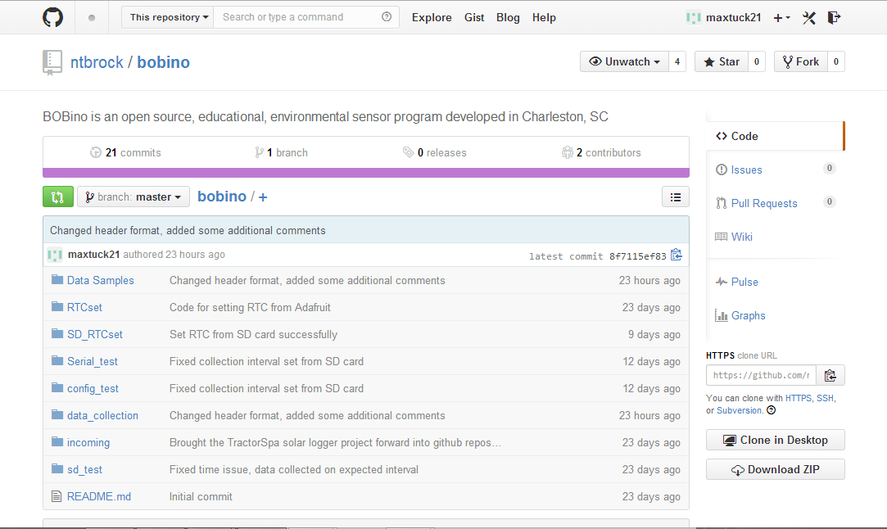

Slide 5
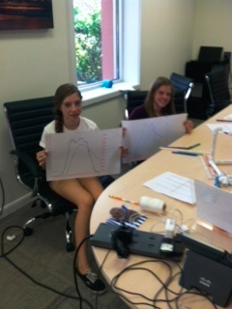
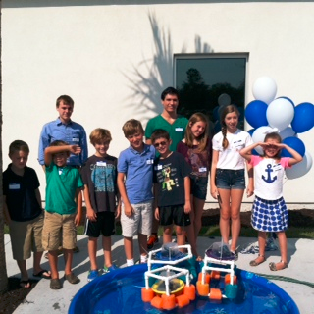
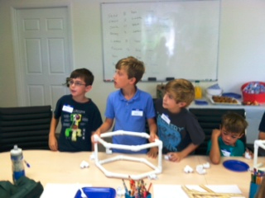

Slide 6
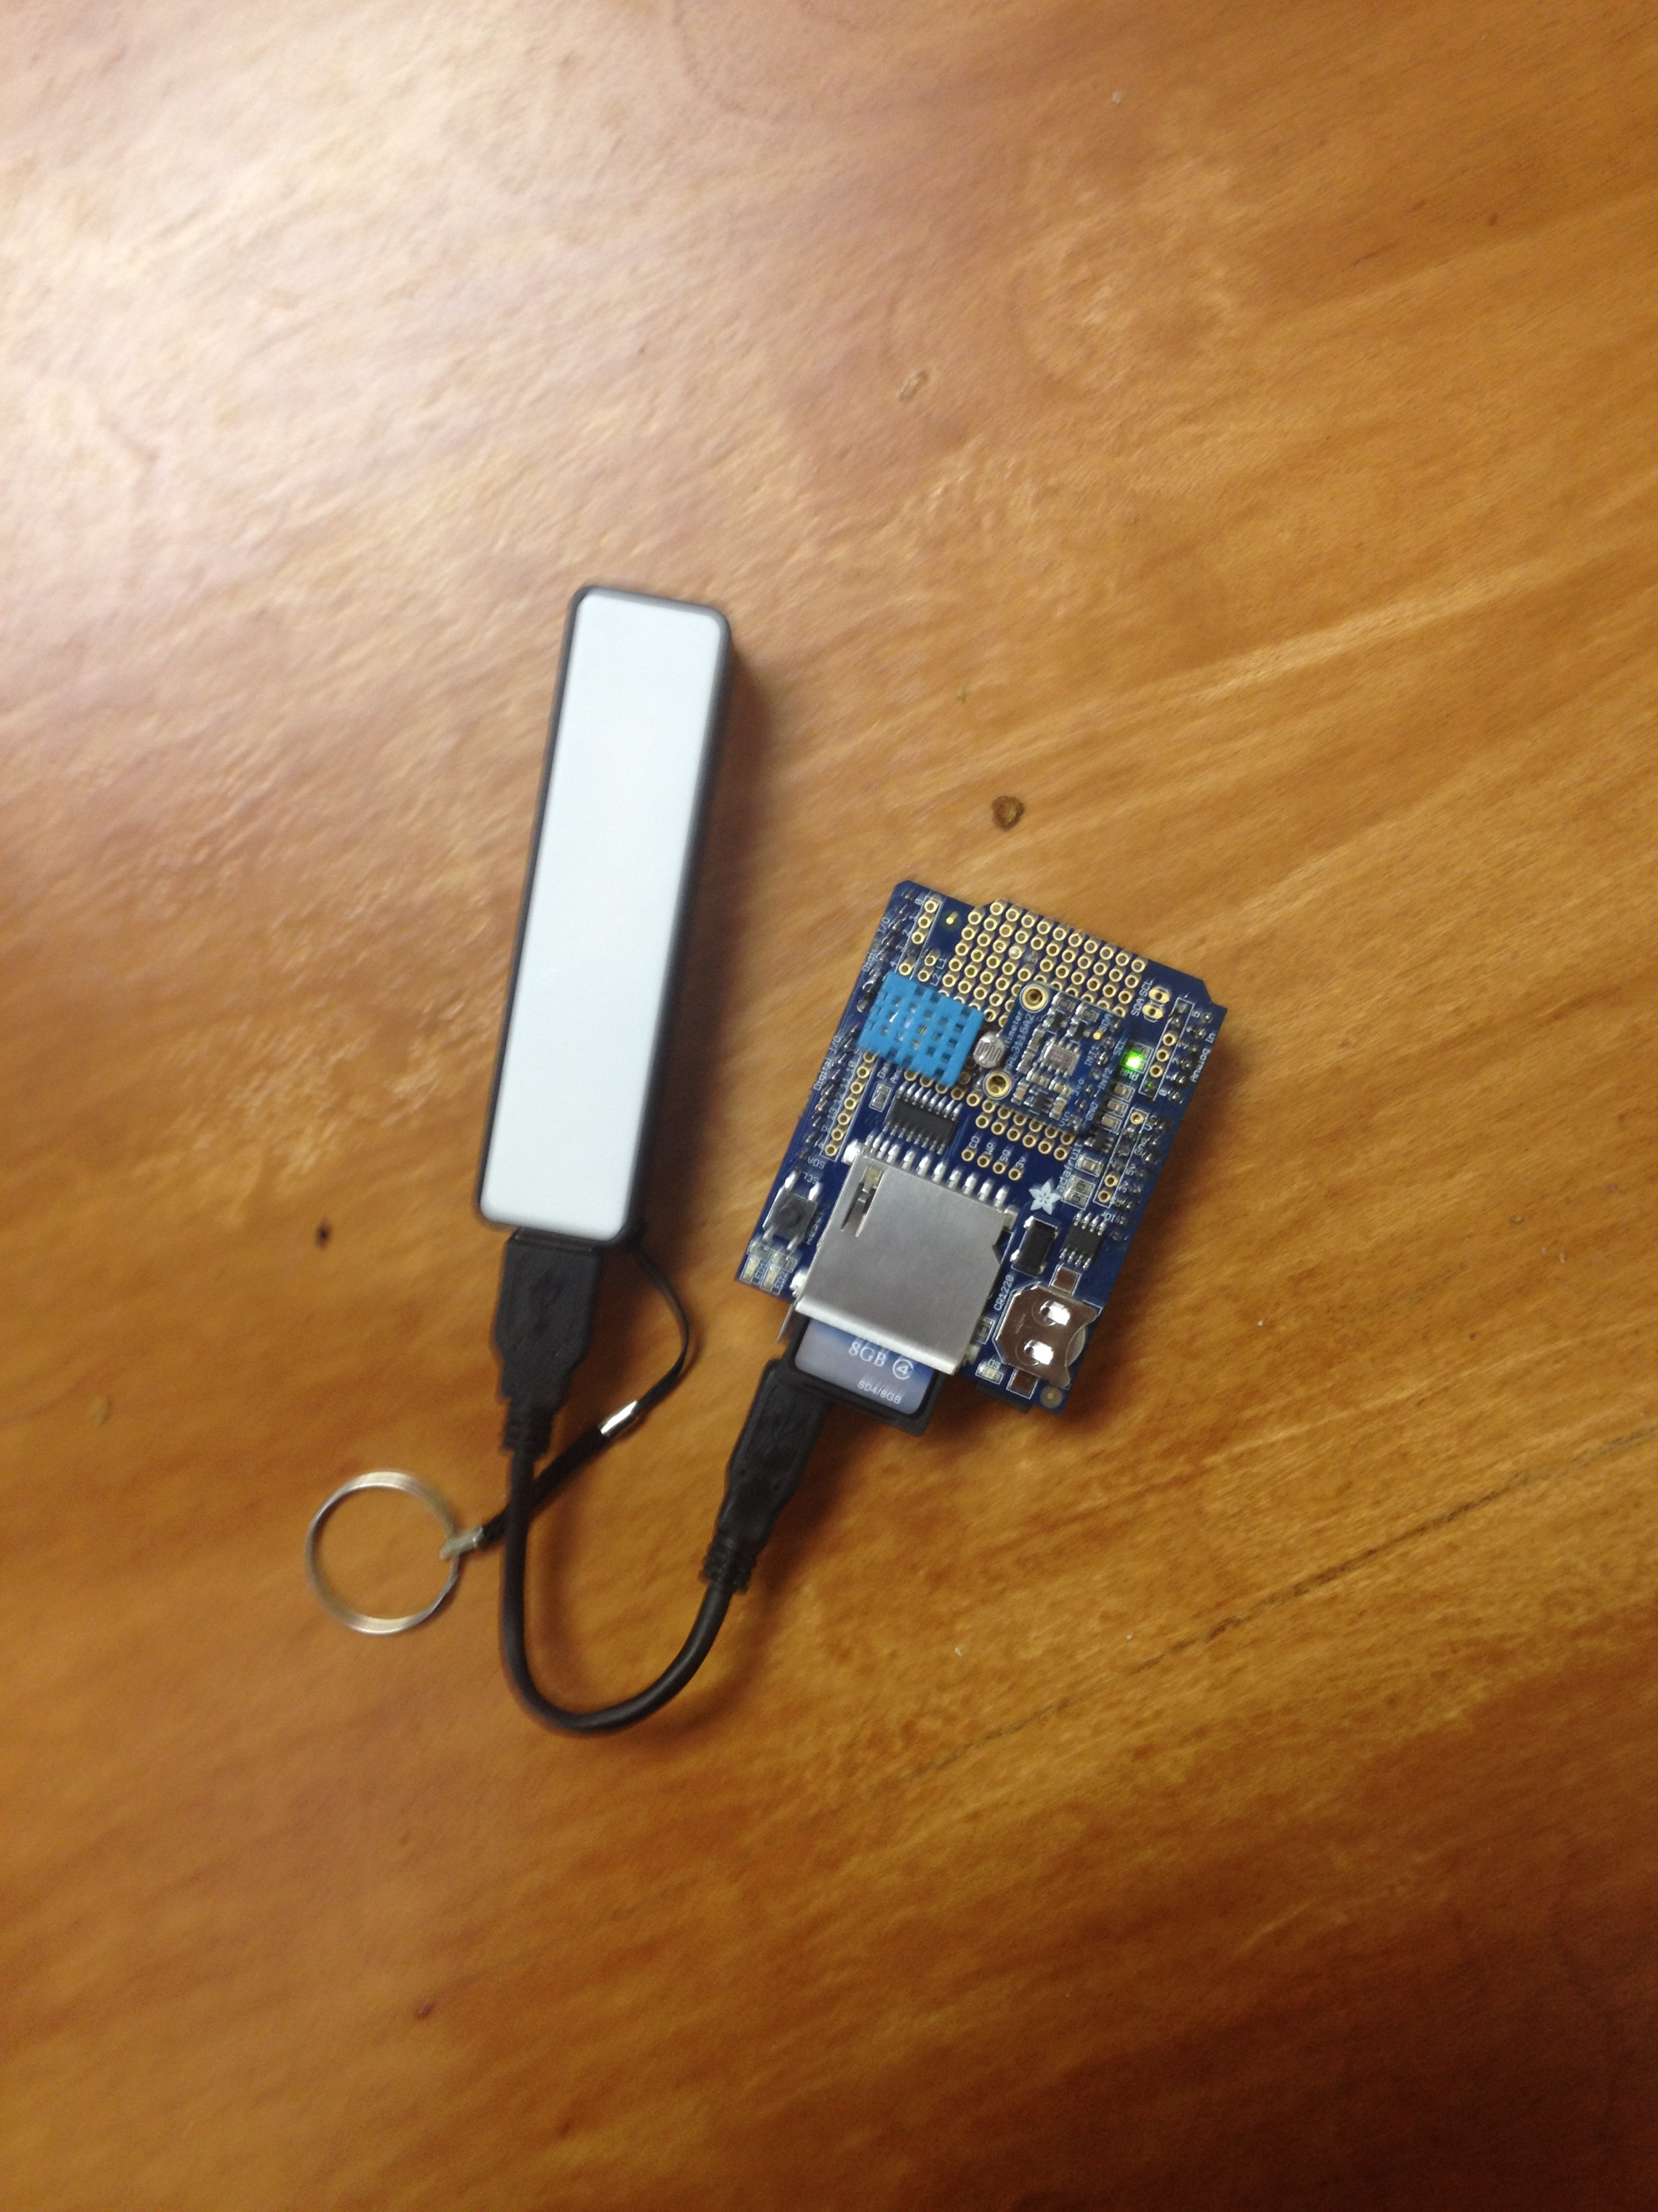
BoBino Operation
Attach SD card shield to Arduino body
Insert SD card into slot
Plug into body, and enclose in tupperware
Place on buoy, and collect data!

Slide 7
Data Analysis

